Slide 1
Gifted and Talented Education
Stage 3, 2020

Slide 2
Philosophy of the class
Every child must succeed in an education worth having. LEPS vision statement (School Plan, 2018-2020)
Department of Education Strategic Plan 2018 – 2022 Every student is known, valued and cared for in our schools. Every student is engaged and challenged to continue to learn.
To provide targeted, specific curriculum differentiation for gifted and talented students in Stage 3 at Lindfield East Public School.
To ensure our school is providing opportunities that enable all students to explore and build on their gifts and talents (Melbourne Declaration on Educational Goals for Young Australians, 2008).

Slide 3
Philosophy continued
2008 GATE Review
UNSW Certificate of Gifted Education (COGE). 9 LEPS teachers have attained the qualification over the years
School-wide professional development in 2018 and previous years has had a strong focus on differentiation.
LEPS academic advisors:
Dr Jill Forster – advisor to the Department of Education and Communities and a range of schools on gifted and talented education policy and best practice.
Dr Catherine Attard – president of the Mathematical Association of NSW, lecturer of Primary Education (Mathematics) at UWS

Slide 4
Advantages
Curriculum compacting (increased pace of delivery)
Clustering like-minded individuals provides a conducive cognitive and emotionally supportive context for learning
Higher levels of engagement
Opportunities for personalised projects
2-year cycle ensures that the students’ needs are identified and catered for effectively
Setting long-term goals for learning and achievement
Class teacher specially trained in Gifted and Talented Education

Slide 5
Benefits to all Stage 3
All other Stage 3 classes will still include a range of ability and performance levels (home classes are not streamed)
Maths Groups are streamed based on performance
Strategies and ideas used will be shared with grade partners
Gifted students are catered for in a purposeful environment to provide an optimal learning environment, with more teacher time available
Teachers will continue to differentiate their teaching program for all students in other Stage 3 classes

Slide 6
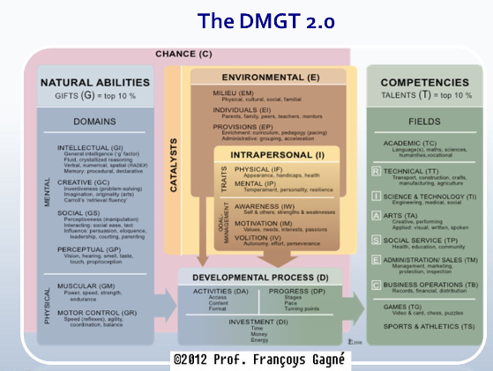
Gagné’s DMGT

Slide 7
Potential and Performance
Giftedness and talent are related, but different...
Giftedness focuses on potential not performance, and ability not achievement.
Talent is the realisation, or evidence, of giftedness.

Slide 8
High Potential and Gifted Education

Slide 9
Who are gifted students?
Gifted students:
- vary in abilities and aptitudes
- vary in levels of giftedness
- vary in achievement
- are not always easy to identify
- exhibit a variety of personal characteristics
- come from all backgrounds, cultures, socio-economic levels and geographic locations

Slide 10
Identification Strategies
Nomination
- Nomination of students through parent nominations and teacher nominations
Screening
- Use of a combination of measures of potential and performance.
Monitoring
- Analysis of data and development of a plan of action for GAT students.
- Collection of information
(E.g. teacher screeners)
- SUBJECTIVE measures
- Ability tests are useful for assessing potential, achievement and performance.
- Use of standardised tests, off-level tests, IQ assessments (where available)
- OBJECTIVE measures
-AGAT (general ability)
- Teachers formally observe these students to give a picture of their performance, interests, strengths and weaknesses.
- Teachers evaluate the effectiveness of provisions already in place.
This is an ongoing process.

Slide 11
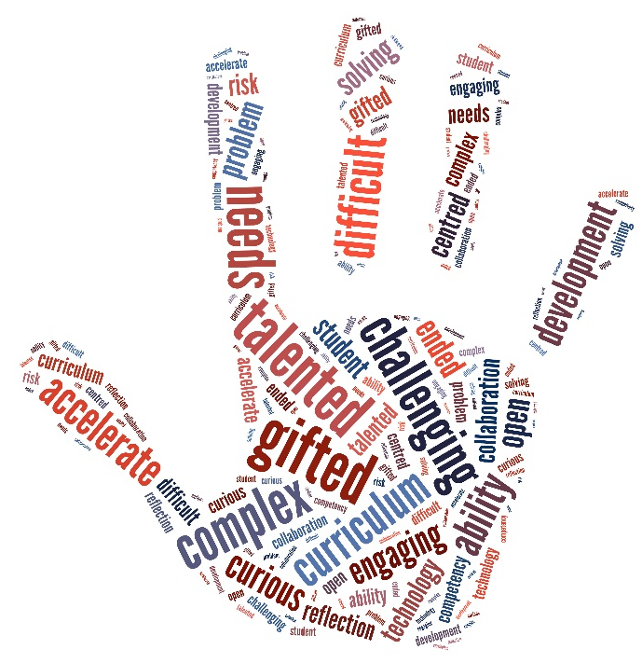
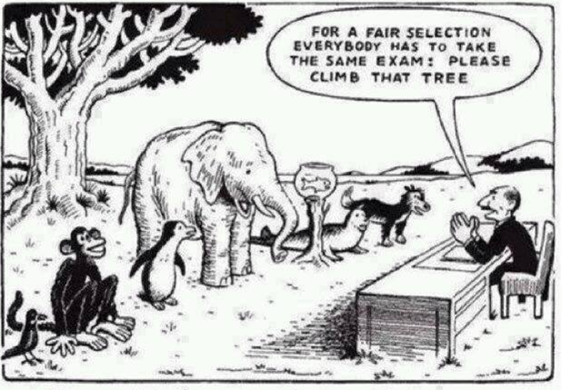
Eligibility and Placement
All students currently enrolled in Years 4 and 5 will be considered

Slide 12
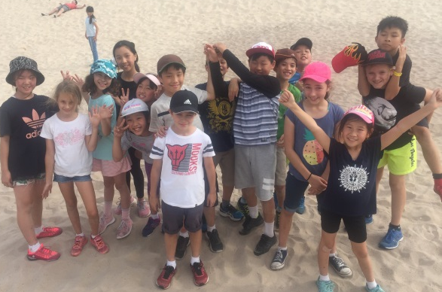
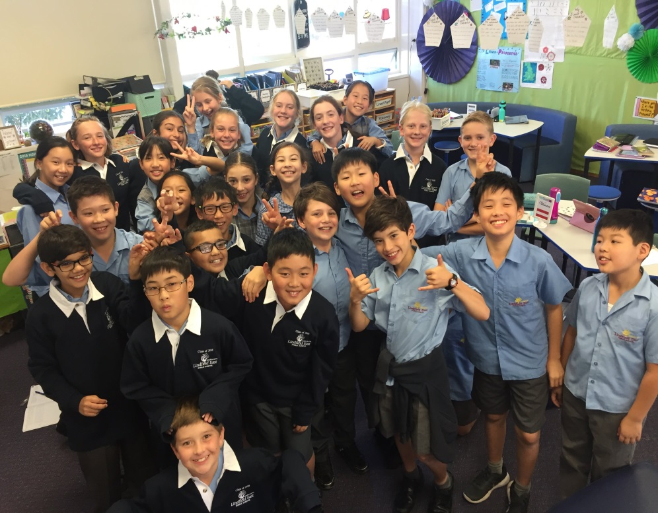
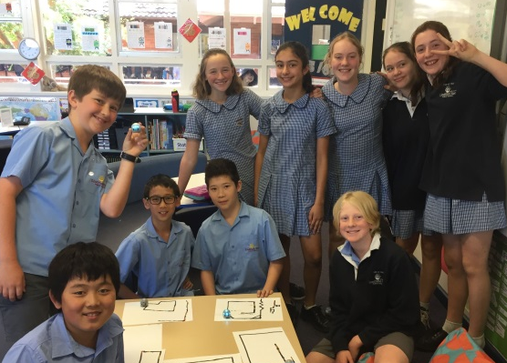
Classroom teacher for 2020

Slide 13
How have you found this class?
10/10 because of all the opportunities I have and lots of things that I love to learn about here.
I enjoy being pushed to the maximum. If I were in another class I think I would feel like I could be doing more. I feel you have understood that all of us are above average and haven’t treated like we know nothing; instead you have made sure we are learning new things, even if they are above the average level.
I really like this class because of the challenge; I can try new things.
The same classmates mean that you don’t need to spend as much time getting to know new people at the start of the year so you can focus on classwork. The project-based approach to learning allows us to learn and enhance our skills at our own desired field of study.
At first, I thought Year 5s would slow us down but it turns out that they are very capable of working in a HA class with us.
It is fun being in a composite class and I like the pace of learning better.

Slide 14
How do you feel about being in the same class for 2 years?
I love the idea that I have half of an old class, and then some fresh blood! We can always learn from each other, and have an idea of each others’ personality! I also love to see how everyone else connects, and learns and grows together.
You stay close with your year in your class for 2 years; teaching routines stay the same and I’m comfortable in our class/teaching environment.
You can stay with friends for a longer time and your teacher will know you better; you can help the Year 5's as well – it teaches us flexibility.
If I stay in the same class next year I won't have to worry about what teachers I'll get next year!

Slide 15
Questions?
How many students will be selected from each year group?
Who will decide which students are selected for the class?
Will the other Stage 3 students ‘miss out’ on opportunities? (e.g. Enrichment days at KHS, Debating Camp, Gifted Writers’ Group)
Is there a waiting list?
What happens if my child is offered an OC placement?
When will we find out who is in the class?
What about subject-specific gifts?

